Slide 1

Bethesda Game Studios
A Presentation By Ezra Higham

Slide 2

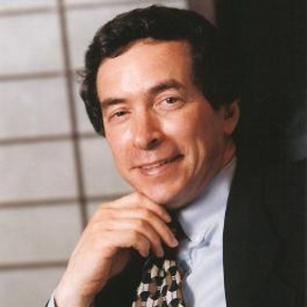

Bethesda Softworks
Established in 1986
Christopher Weaver

Slide 3




Slide 4

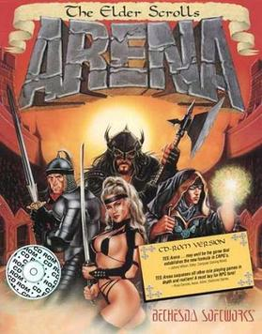
The Elder Scrolls I: Arena 1994
Ambitious project
Early 3d design
First of its kind to give the player freedom to do what they want

Slide 5

Elder Scrolls II: Daggerfall 1996
Increased attention to RPG elements
One of the larges videogame maps ever

Slide 6

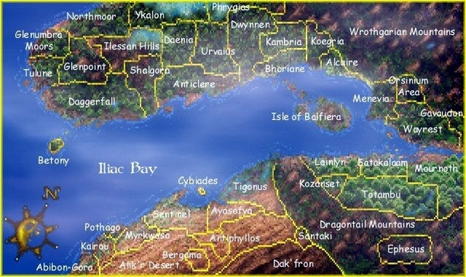
161,600 square kilometers

Slide 7

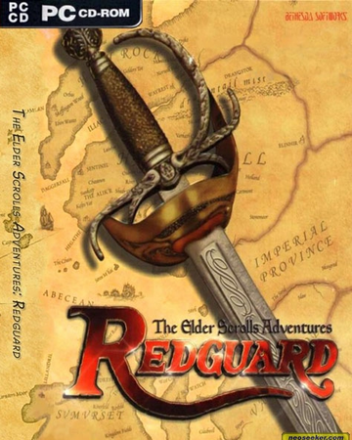
Battlespire & Redguard
Did not sell well
Not very notable games

Slide 8
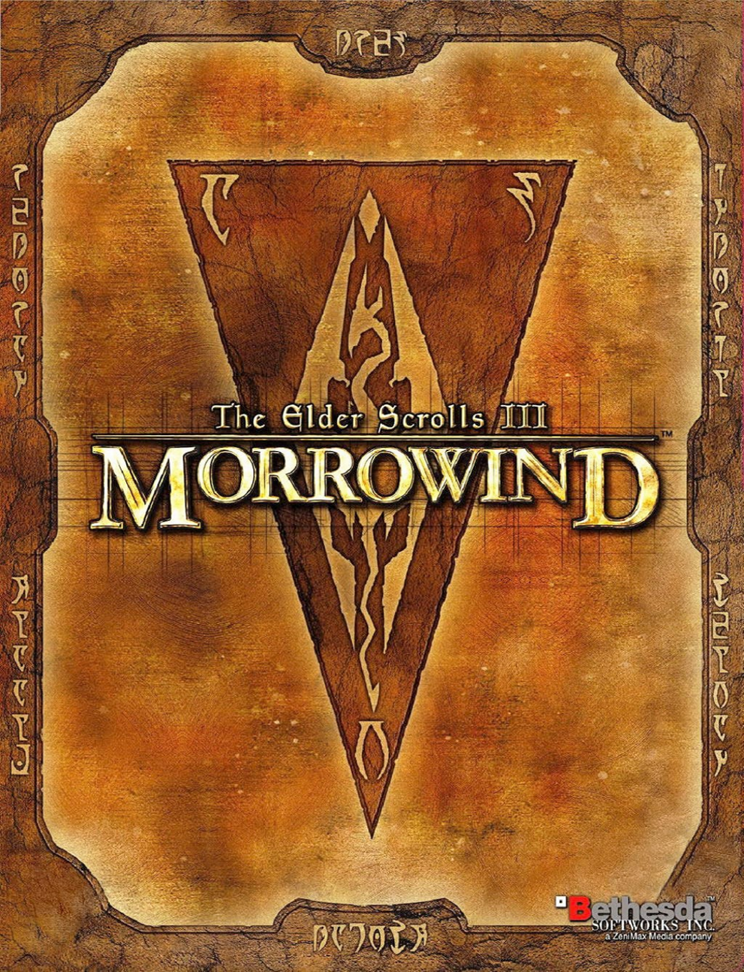
Elder Scrolls III: Morrowind 2002
Saved them from having to shut down the studio
Their first game put on consoles
A fan favorite

Slide 9
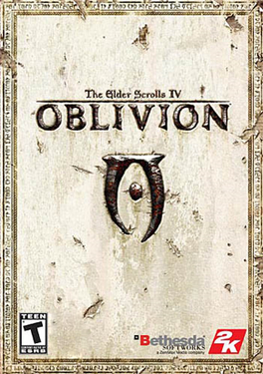
Elder Scrolls IV: Oblivion 2006
Opertunity to learn how to optimize games for consoles
Procedural generation landscapes mixed with hand crafted environments
Not enough staff for such a large project
10 – 11 voice actors with over 70,000 lines of dialog that couldn't fit onto the disk

Slide 10

Falout 3 2008
Their first fallout game
Gun combat was new to Bethesda

Slide 11
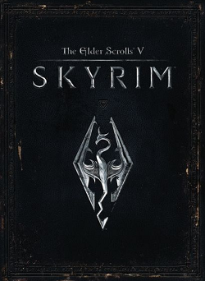
Elder Scrolls V: Skyrim 2011
Most popular game to date
Top 20 best selling games of all time
Developed a large modding community

Slide 12
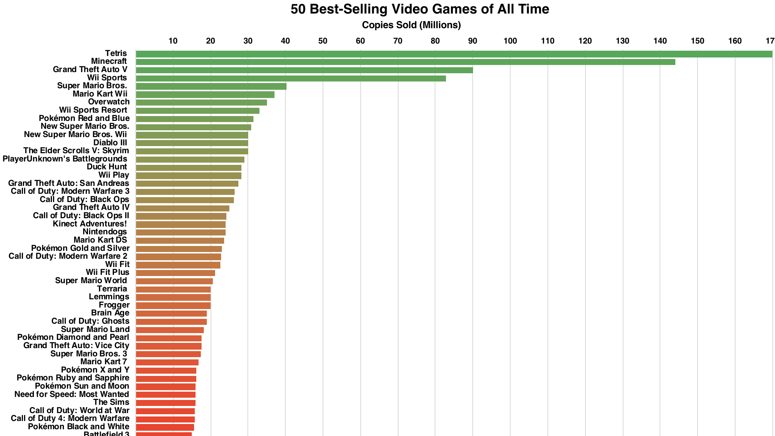
Over 20 million copies sold

Slide 13

Fallout 4 2015
Technical challenges to make the environment feel alive
Density over scale
Enriched mechanics to make gameplay feel better

Slide 14
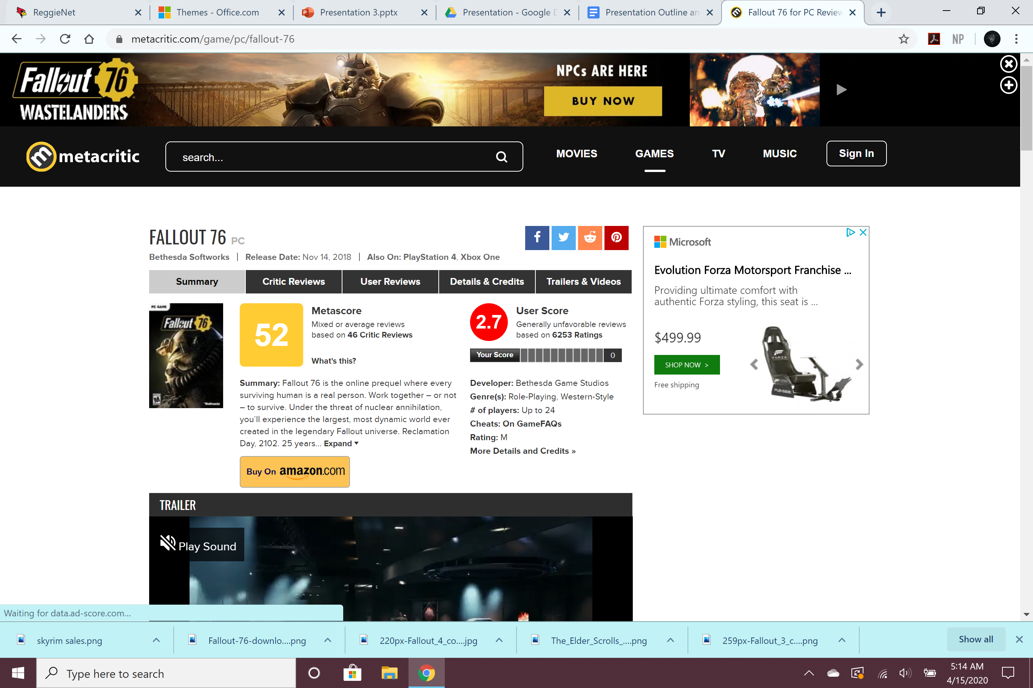

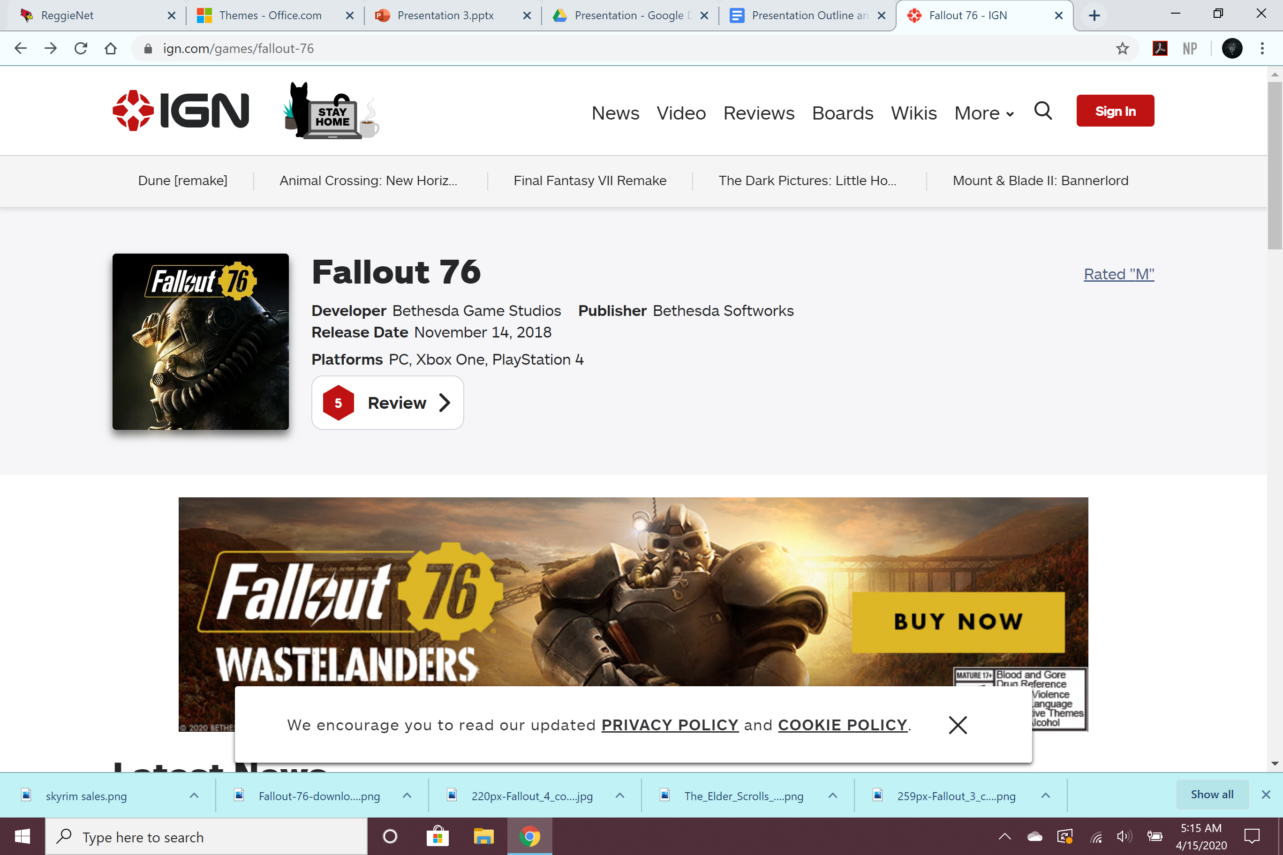
Fallout 76 2018
The most poorly received game from their playlist
Bethesda's first online multiplayer game
Unfortunate sketchy business practices

Slide 15
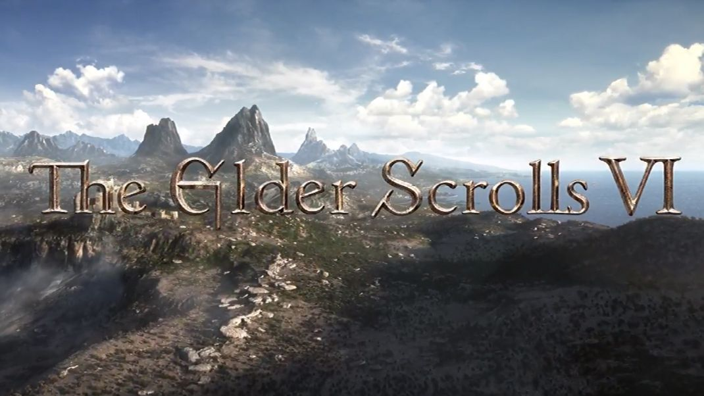

Bethesda’s Future
Very secretive about their projects.
High hopes but nervous fans.

Slide 16

Thank You!

Slide 17
sources
https://www.metacritic.com/game/pc/fallout-76
https://www.ign.com/articles/2018/11/22/fallout-76-review
https://www.youtube.com/watch?v=FDxBvwj4HmU
https://www.youtube.com/watch?v=QKn9yiLVlMM
https://www.youtube.com/watch?v=kjyeCdd-dl8
https://www.youtube.com/watch?v=LwXV0oLEfCM

